Slide 1
Mental Health in The Gender Diverse Community
North Dakota Family Based Services Conference
April 11, 2024
Dan Sturgill, Ph.D.
Clinical Psychologist
Sanford Health
Moorhead, MN

Slide 2
THANK YOU!!
Alice Christianson
for a year of education and mentoring
Rebecca Salinas
for sparking my interest in this wonderful segment of our population
All Gender Diverse People I have met
for patience, trust, and shared stories of struggle, beauty, and wisdom.

Slide 3
BACKGROUND
Cisgender male
Trained at UND to be general psychologist in a rural area
Worked with adolescents and adults in Kansas
Returned to Fargo in 2011 (currently working in Moorhead)
Started gender work in 2014
More and more work with adolescents
Many evaluations focused on mental health readiness for medical care
WPATH GEI SOC8 Certified Member
Slide # 1

Slide 4
OBJECTIVES
Review terminology important to gender and sexuality.
Identify best practices in working with gender diverse clients.
Develop appreciation for the variety of gender presentations and experiences in our youth.
Review myths stemming from the current political climate
Learn one way to conceptualize the needs of gender diverse youth in your practice.
Slide # 2

Slide 5
Personal Exercise
What kind of a boy, girl, or other gender were you when you were 14 years old?
As you have developed, what has changed and what has remained the same?
Has the way that you present your gender to the world changed over time?
ARE YOU STILL THE SAME GENDER YOU WERE AT 14 YEARS OLD?
Slide # 3

Slide 6
GENDER TERMS
Unless we are conducting research, honor people’s naming of themselves
These terms will change over time
(example: “Queer.”)
Slide # 4

Slide 7
UMBRELLA TERMS FOR GENDER
Gender Diverse or Gender Expansive
not following cultural stereotypes related to the assignment of sex at birth
previously gender nonconforming or gender variant
sometimes referred to as TGD (transgender and gender diverse)
Slide # 5

Slide 8
GENDER and Sexual Orientation
Sex assigned at birth – male, female, intersex
Gender Identity – one’s inner concept (male, female, bi-gender queer, etc.)
Gender Expression – external appearance of one’s gender(behavior, clothing, etc.)
Sexual Orientation – heterosexual, gay/lesbian, bisexual, pansexual, asexual, etc.
Romantically Attracted – males, females, both, neither.
Slide # 6

Slide 9
GENDER TERMS
Transgender – gender identity differs from sex assigned at birth
Cisgender – gender identity is same as sex assigned at birth
Transsexual – usually associated with a medical transition from one binary gender to another (avoid usage, unless asked to use)
Agender – absence of or neutral experience of gender
Bigender – simultaneously experiencing two or more genders
Gender Fluid – identity that fluctuates over time
Gender Queer – outside or in between the binaries of male and female
Two Spirit – used by some indigenous communities to denote a sacred complexity to a person’s gender identity and/or expression
Slide # 7

Slide 10
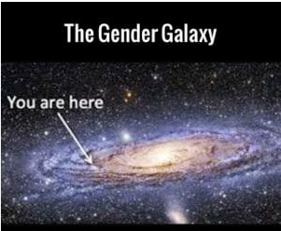
The Gender Universe
Is there a gender experience?
(agender versus gender)
2. Is the gender experience binary?
(nonbinary versus transgender)
Is the gender experience a mixture?
(bigender versus monogender)
Is the gender experience fluctuating?
(gender fluid versus stable)
Slide # 8

Slide 11
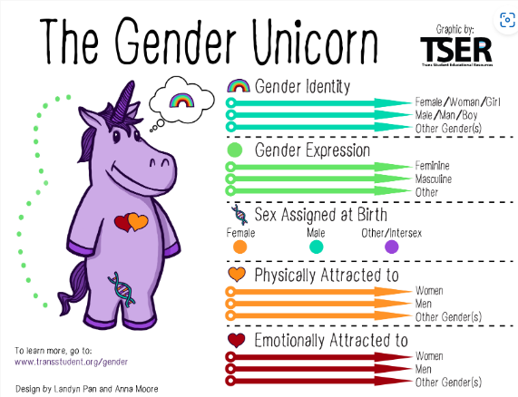
Slide # 9

Slide 12
WHAT WE KNOW
Gender and Sexual Diversity is a part of nature
Conversion Therapy Does not work
Does not work
Does damage
Rejected by medical establishment
22 states have banned this therapy
ND social workers have a ban
Slide # 10

Slide 13
Important Gender Health Care Concepts
1. Youth know their identities, and we need to affirm them.
2. Identities are not diagnoses.
3. We all have a role in working with gender expansive patients
4. There is no single treatment path for gender dysphoria.
5. Treatment is available.
Slide # 11

Slide 14
People know their identities, and we need to affirm them as they evolve.
People understand gender from an early age
Societal expectations may make this go underground
Puberty often exacerbates the incongruence
Let people guide language about who they are
Slide # 12

Slide 15
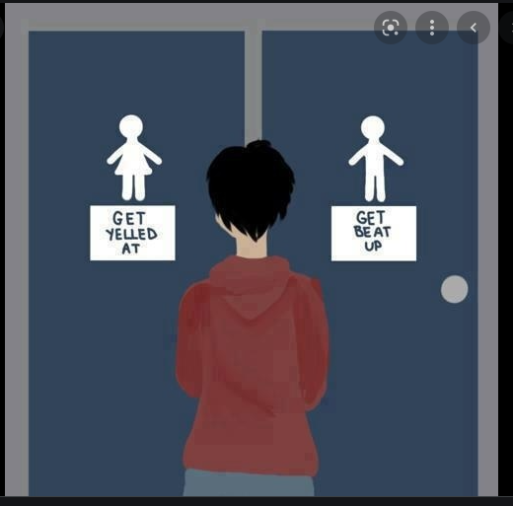
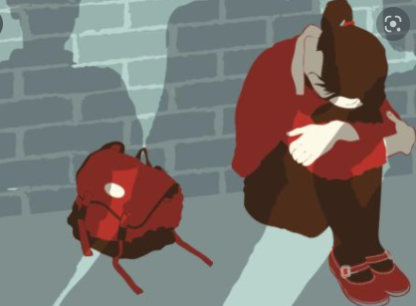
Minority Stress Theory
Identities are not diagnoses
Gender minorities experience a hostile, cis-normative (transphobic) culture that leads to a lifetime of
- Harassment,
- Maltreatment,
- Discrimination
- Victimization
- Minimization
that leads to physical and psychological stress that can be triggering of mental and physical health conditions.
Meyer, I.H. (1995). Minority stress and mental health in gay men. Journal of Health and Social Behavior, 36, 38-56.
Slide # 13

Slide 16
Identities are not diagnoses
Male, female, transgender, agender, bigender, etc., are all identities
Gender dysphoria is what we treat
Minority stress increases the risk for mental/physical concerns
Not everybody with a gender expansive identity has gender dysphoria
Slide # 14

Slide 17
We all have a role in this.
Prevalence of red hair is similar to transgender population
Our clinical and parental skills are important here: LISTEN
Every medical / mental health credentialing body indicates that we are ethically bound to provide care.
Slide # 15

Slide 18
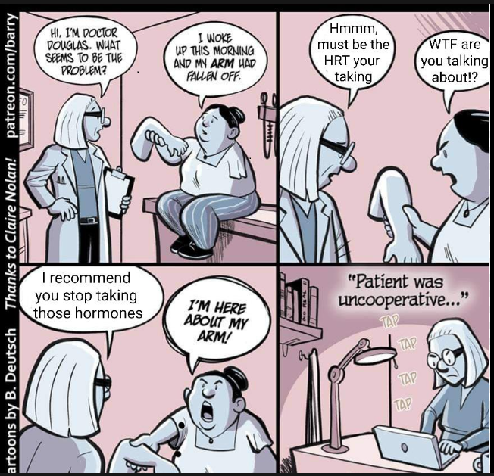
Transgender Broken Arm Syndrome
Tendency for medical providers to assume that problems are a result of gender and/or gender affirming medical care.
Youth may not have any problems associated with their gender experience.
If youth have a crisis, it does not make sense to stop care, unless reviewed by the team that started the care.
Slide # 16

Slide 19
No single treatment path for treatment of gender dysphoria.
Most people do not need every treatment
(example: trans man who needs top surgery but not testosterone)
Goals may be related to body (embodiment) and/or social needs
People may not have a goal of “blending” with a gender (Note: “passing” assumes binary expression is superior, so “blending” is becoming the preferred term)
Slide # 17

Slide 20
GENDER DYSPHORIA IN ADULTHOOD AND ADOLESCENCE (DSM-V)
A marked incongruence between one’s experienced/expressed gender and assigned gender, of at least 6 months duration, as manifested by at least two of the following:
A marked incongruence between one’s experienced/expressed gender and primary and/or secondary sex characteristics (or in young adolescents, the anticipated secondary sex characteristics.)
Strong desire to be rid of one’s primary and/or secondary sex characteristics because of a marked incongruence with one’s experience/experienced gender (or in young adolescents, a desire to prevent the development of the anticipated secondary sex characteristics)
A strong desire for the primary and or secondary sex characteristics of the other gender
A strong desire to be of the other gender (or some alternative gender different from one’s assigned gender)
A strong desire to be treated as the other gender (or some alternative gender different from one’s assigned gender)
A strong conviction that one has the typical feelings and reactions of the other gender (or some alternative gender different from one’s assigned gender)
The condition is associated with clinically significant distress or impairment in social, occupational, or other important areas of functioning.
Slide # 18

Slide 21
GENDER DYSPHORIA AT A GLANCE
Incongruence between experienced/expressed gender and assigned gender (six months or longer)
Any two of the following, combined with distress and / or functional difficulties:
Sex assigned at birth ≠ gender identity or expression
Disgusted by own sexual characteristics
Distressed by absence of other sexual characteristics
Wanting to be other gender
Wanting to be perceived as other gender
Perceives self to feel and act as other gender
Slide # 19

Slide 22
Co-morbidity with Gender Dysphoria
DEPRESSION –
- much more likely in gender diverse individuals
- may be driven by internalized gender-negative messages
ANXIETY –
- worry may be related to gender issues
- social anxiety, and avoidance increases anxiety
- may be more vulnerable to traumatic experiences occurring
EATING DISORDERS –
- disordered eating may be related to attempts to control the gendered body experience
AUTISM SPECTRUM TRAITS –
- 1% of general population meet criteria (6-7% may have significant traits)
- 5% to 20% of gender diverse meet criteria (14 to 36% with significant traits)
- nonbinary (especially AFAB) may even be more likely
DISSOCIATIVE DISORDERS –
- estimates in gender diverse population have been as high as 30% (general pop = 2%)
- may be attempt to dissociate from gender experience
SUBSTANCE USE –
- may be an attempt to numb out from gender experience
BODY DYSMORPHIC DISORER –
- not any more common in gender diverse population than general population
- gender dysphoria can lead to unhealthy focus on pursuing perfection
Slide # 20

Slide 23
Suicidality and Transgender Youth
82% have considered killing themselves
40% have attempted suicide
Austin A, Craig SL, D'Souza S, McInroy LB. Suicidality Among Transgender Youth: Elucidating the Role of Interpersonal Risk Factors. J Interpers Violence. 2022 Mar;37(5-6):NP2696-NP2718.
Slide # 21

Slide 24
Tasks of Psychotherapy for Youth
Provide safe environment to explore authentic expressions of gender identity
Address the reality of stigma and minority stress and develop personal plan for resiliency
Facilitate coming out process (if needed)
Family therapy or support for family members. Help to teach active listening.
Ongoing psychotherapy is best practice when medical treatments are considered
Slide # 22

Slide 25
What to do for gender non-conforming child and family?
Community support and advocating
Affirm the experience (not pathologize)
Referrals as necessary
Education for patient and parents
Stabilize other mental health conditions
Slide # 23

Slide 26
Gender Identity Milestones
First thoughts about gender being different
First recognized might be transgender
First disclosures to others
First began to change gender expression
Slide # 24

Slide 27
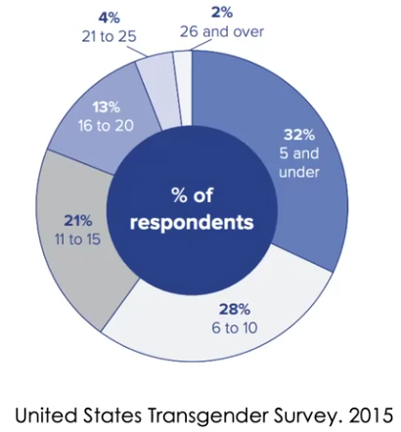
Initial Understanding of Gender Different from Birth Assignment
60% - 10 years or younger
21% - 11 to 15 years old
19% - 16 years or older
Slide # 25

Slide 28
First Thoughts of Gender
Feeling different from others
Disappointment at learning about pubertal changes
Upset about gender norms
Slide # 26

Slide 29
First Recognized Might Be Transgender
May learn about from media or peers (finding their tribe)
May have initial paradoxical response (overcompensate)
May talk with others tentatively and backtrack
May label it differently to start with (nonbinary / gay)
Slide # 27

Slide 30
First Disclosures to Others
May happen multiple times with retractions
Frequently to friends first
May come out to one family member (mother, sister, etc)
May live two separate lives for some time
Slide # 28

Slide 31
Changing Gender Expression
Pronouns
Clothing
Binding, padding, packing, tucking etc.
Slide # 29

Slide 32
What are some of the ways gender diversity comes into our office?

Slide 33
Trajectory for Those Coming Out as Children
Distress pronounced around social aspects
Not as much body dysphoria (until puberty)
Usually a couple of years of “convincing” family
Easier to transition as a child
Bubble of protection until puberty (parents more affirming)
Just want to be seen as a “boy/girl”
Harder to engage about their trans experience
Slide # 30

Slide 34
Trajectory for Adolescent Coming Out in Adolescence
Puberty is when distress about gender begins or intensifies
May begin to explore (coming in) their private gender experience
Coming out to others and may embrace trans experience
May seem very sudden when they start asking for medical interventions
May have a gender expression that is neutral or congruent with assigned sex
Slide # 31

Slide 35
Differences between Trans Boys and Girls
TRANS BOYS (girl assigned) TRANS GIRLS (boy assigned)
1) Childhood may be “normal” 1) “Always felt different”
2) Bullied later 2) Bullied earlier
3) Puberty = sudden pain 3) Slower puberty pain
However, EVERYBODY HAS THEIR OWN EXPERIENCE
Slide # 32

Slide 36
HB1254 in North Dakota
Makes it illegal for a medical clinician to prescribe medications or perform procedures to treat gender incongruence for patients under age 18.
DOES NOT:
Affect adult care in any way.
Change our ability to talk with patients about their identity
Preclude practitioners from making appropriate referrals
Keep mental health professionals from assessing and treating
Keep us from providing follow-up care (labs, wound care, patient education, etc.)
Keep pharmacies from filling medications prescribed
NOTE: There is nothing patients or families can do that is illegal under this bill.
Care is available in Minnesota
Slide # 33

Slide 37
DISPELLING MYTHS ABOUT GENDER AFFIRMING CARE
Coordinated attacks on gender affirming care (mostly for youth) have been related to ideology rather than science
No pre-pubertal children are being provided medical care
Genital surgeries under 18 are exceedingly rare
Gender care is not experimental. We have decades of research showing positive results of treatment.
Youth have extensive evaluations before starting treatment.
Parents are always a part of the evaluation and consent process.
After puberty, changes in gender identity are very rare.
“Detransition” rates are low, and include people who are not dissatisfied with treatment
All major medical associations acknowledge treatment options for youth as important care.
Slide # 34

Slide 38
Messages for families learning about child with diversity
Although there can be a lot of fluidity in gender experience before puberty, post-pubertal individuals frequently have a set gender experience (not a phase.) GENDER DIVERSITY MAY EVOLVE BUT UNLIKELY TO DISAPPEAR
Affirming a patient’s gender experience (name, pronouns, gender expression), allows a young person to refine their understanding of who they are. Arguments tend to entrench youth in their initial inflexible thinking. Identity exploration should be encouraged for best development.
Gender assessments (if needed) are extensive and will rule out other causes of possible gender experience.
Medical interventions are different from affirming identity. Not everybody needs every intervention.
Slide # 35

Slide 39
What if a young person is requesting medical care?

Slide 40
First version of these standards was published in 1979.
Version 8 was released in September 2022 (version 7 came out in 2011)
SOC8 is over 270 pages and documents extensive research
Medical providers recognize this internationally as a document to guide care.
Slide # 36

Slide 41
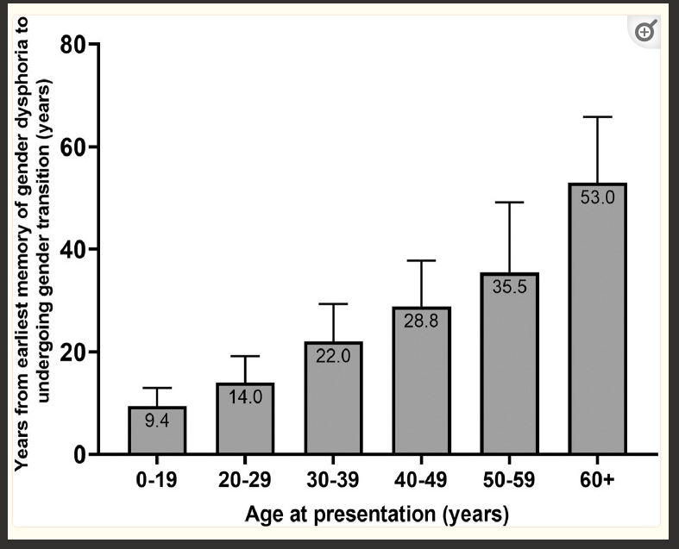
Years from First Memory of Gender Incongruence to
Initiation of Gender Care
When families first hear about gender, youth have been dealing with it for years
Initial uncomfortableness is frequently ignored until puberty or other developmental milestones
Challenges such as autism, trauma, or other disruptions in life can further delay coming out
Zaliznyak M, Yuan N, Bresee C, Freedman A, Garcia MM. How Early in Life do Transgender Adults Begin to Experience Gender Dysphoria? Why This Matters for Patients, Providers, and for Our Healthcare System. Sex Med. 2021 Dec;9(6):100448. doi: 10.1016/j.esxm.2021.100448. Epub 2021 Oct 31. PMID: 34731778; PMCID: PMC8766261.
Slide # 37

Slide 42
Quick Tour of Gender Affirming Procedures
The following slides are a quick overview to know what patient’s may be seeking.
You do not need to know everything before making a referral.
Let those with expertise sort through medical issues.
Affirming their gender in the appointment is your best practice role.
Slide # 38

Slide 43
Affirming Practices
Social transition (non-medical)
Change in gender expression
Change in pronouns
Change in gender markers
Packing, binding, tucking, etc.
Slide # 39

Slide 44
Medical Care For Gender Dysphoria
ADULTS
YOUTH
Informed consent model
Focus on understanding of embodiment goals and understanding of treatment
Further assessment recommended if co-occurring conditions exist that could get in the way of treatment
Must complete extensive evaluation
Must have other conditions addressed
Must evaluate many factors:
Trauma, body image issues, social impacts, neurodiversity, cognitive and emotional maturity, parental functioning, co-occurring mental and medical conditions, stability of identity experience, etc.
Slide # 40

Slide 45
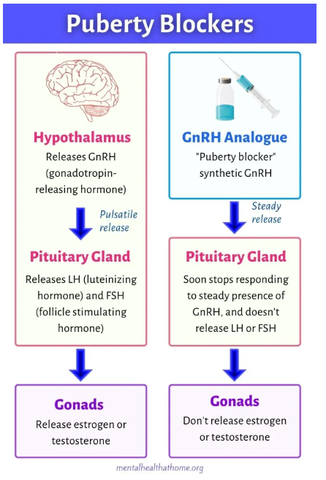
Puberty blocking:
Is a way of producing a steady stream of GnRH, similar to what is produced in the hypothalamus
Has been used safely in patients with precocious puberty since the 1980’s, with FDA approval in 1993.
We have lots of data to suggest that bone health into adulthood is not significantly effected, if guidelines are followed.
Although we don’t know everything, risks have been greatly exaggerated, even in journal articles.
Slide # 41

Slide 46
Quick Tour of Procedures
Puberty blocking (example: triptulorine)
- Must have entered puberty (Tanner Stage II)
- Must have extended history of gender incongruity
- Must have bio-psycho-social evaluation
- Must have parental consent
- Fully reversible
- Minimal risks, if discontinued within a few year
Slide # 42

Slide 47
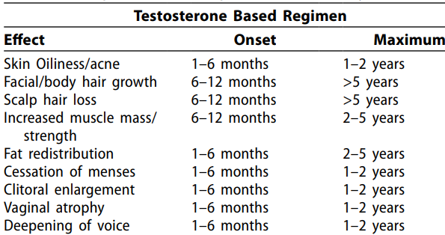
Masculinizing Hormone Treatment
Slide # 43

Slide 48
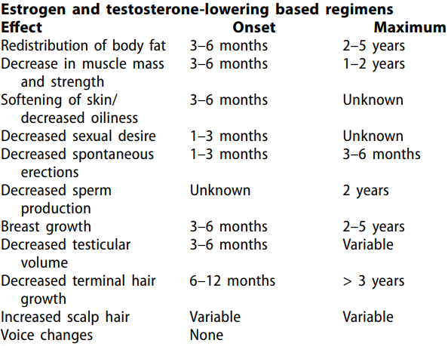
Feminizing Hormone Treatment
Slide # 44

Slide 49
Challenges for Youth Care
There is significant evidence that youth with gender dysphoria suffer greatly.
There is significant evidence that many youth benefit greatly from early medical intervention.
Most compelling evidence of efficacy is for individuals who were gender diverse early in life.
While not as well documented, we know that later emergence of gender dysphoria is one experience that does respond well to treatment.
We have no way of knowing who will desist and who will maintain their embodiment goals (may be different from identity), but this is rare.
Slide # 45

Slide 50
Challenges for Youth Care
Retransition literature is hard to generalize to particular clinical situations (probably somewhere between 1 to 6%) because studies can include many situations that are quite different from each other, changes in treatment plan can come from a variety of experiences:
Social pressures
Effects of treatment not anticipated
Change in embodiment goals
Change in identity experience
“Was never my identity experience” – very rare
Polarization and politicization of this issue has created dissonance and sometimes “the fight” can become the driving issue and obscure the possibility of other interventions
OVERALL GOAL IN EVALUATIONS FOR MEDICAL CARE: Provide information to family and youth about the possible risks and benefits of starting care.
Doing nothing is not a neutral choice. Going through an incongruent puberty can have devastating consequences.
Slide # 46

Slide 51
ADOLESCENT ASSESSMENTS ADDRESS THE FOLLOWING QUESTIONS:
Are there any other interventions that would safely address distress?
Is evidence present that this gender experience is long-standing and stable?
Have other mental health conditions been identified and addressed (PTSD, Eating Disorders, Autism, Depression and Anxiety, Body Dysmorphia, Psychosis, Dissociative Disorder, etc.)
Is there any evidence that the patient’s lack of social or emotional maturity is impacting the patient’s understanding of their experience (social influence, etc.)?
Do both the patient and the parents:
- show the ability to understand the pros and cons of beginning this treatment?
- fully understand the physical and social aspects of starting this treatment?
- understand the need for ongoing assessment, in order to determine treatment efficacy and any need for changes in treatment plan?
If you have not had the training, experience, and supervision for this care, please bring a team member on board who has this expertise.
Slide # 47

Slide 52
Why is the evidence base so confusing?
People are reading the same research and coming to different conclusions
We cannot have randomized controlled studies
We may never know if it is the medical intervention or other factors that are helping our youth
As a clinician, I see families that are reporting significant and positive changes in their lives.
Successful decisions are made together with a team and in an individualized way.
Slide # 48

Slide 53
CARE IS MOST LIKELY TO BE HELPFUL WHEN
Other mental health conditions are well-managed
There is a multi-disciplinary team approach
There is social and family support around the transition
Slide # 49

Slide 54
MAJOR TAKE HOME IDEAS
Do not get hung up on the medical questions. Acknowledge the pain while evaluating needs.
Look for ways to provide safe environments.
Focus on managing other symptoms and enhancing resiliency factors.
Find ways to love and respect the experience of every young person.
Slide # 53

Slide 55
Case Example (composite)
Preferred name Mendel
Age 15; Assigned female at birth (AFAB)
Nonbinary, masculine leaning
Using he/him pronouns; Wants to live as a male
Intact family – Norwegian mother; Mexican American father
Slide # 50

Slide 56
Mendel
Very “girly” in elementary school, but with a tomboy flare
Enjoyed sports and very good in school
Puberty started at age 11
Became more sullen and reclusive
Diagnosed with depression, anxiety and an eating disorder
At age 13, hospitalized for an overdose attempt
While in hospital, discloses transgender identity
Slide # 51

Slide 57
What are you curious about in conceptualizing this case? What are some ways to support this adolescent and family?
Community support and advocating
Affirm the experience (not pathologize)
Referrals as necessary
Education for patient and parents
Stabilize other mental health conditions
REVIEW OF MENDEL’S HISTORY:
Age 15; Assigned female at birth (AFAB)
Nonbinary, masculine leaning
Using he/him pronouns; Wants to live as a male
Intact family – Norwegian Mom; Mexican American Dad
Very “girly” in elementary school
Enjoyed sports and very good in school
Puberty started at age 11
Became more sullen and reclusive
Diagnosed with MDD, GAD, ED
At age 13, hospitalized for an overdose attempt
While in hospital, discloses transgender identity
Slide # 52

Slide 58
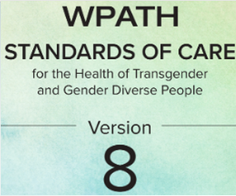
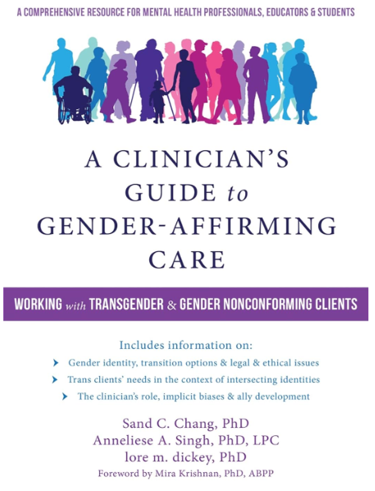
KEY REFERENCES
World Professional Association for Transgender Health, Standards of Care 8:
https://www.tandfonline.com/doi/pdf/10.1080/26895269.2022.2100644
A Clinician’s Guide to Gender Affirming Care
by Chang, Singh, and dickey
https://workshops.genderhealthtraining.com/
Free workshops, $30 for CEU’s
Slide # 54

Slide 59
KEY REFERENCES
Principles of Transgender Medicine and Surgery, 2nd Edition, by Randi Ettner, Stan Monstrey, and Eli Coleman (2016)
- associated with WPATH - children and adults
- great review of research (reference) - multiple authors
2) Transgender Mental Health by Eric Yarbrough, MD (2018)
- president of LGBTQ Psychiatrists - only adults
- meant as guidebook (cover to cover) - single author
Slide # 55

Slide 60
KEY RESOURCES (Families)
Transgender Teen, by Stephanie Brill and Lisa Kenney
2) The Gender Identity Workbook for Kids by Kelly Storck
Slide # 56

Slide 61
CONTACT INFORMATION
Dan Sturgill, Ph.D.
He/him; cisgender man; ally
Danial.Sturgill@sanfordhealth.org
701-417-6999
Transgender and Gender Diverse Health Coalition
3rd Monday of each month, over the Noon hour
Message Dan if you would like to be added to the Webex invite
Slide # 57

